Slide 1
















Capstone Project Presentation
By: Oluwayomi Ojo, Yinka Olaniyi, Sukmanjit Singh, Mau Lam Tuan
Topic: Email Classification for Helpdesk

Slide 2

Introduction
The increase in email volume poses challenges in effective communication and efficient management.
Manual Email classification is time-consuming .and expensive. Automating this process could save substantial time for helpdesk agents, allowing them to prioritize critical tasks
Email Classification project focused on developing a machine learning model for email content classification.

Slide 3
01.
The nature of email content is varied and unstructured. Therefore, it cannot be processed as structured data
Problem Statements
. T
02.
Exixting solutions are half AI solutions, and they are fragile solutions. Therefore, not reliable
Lack of suitable data, especially with sensitive business email. Generative AI to create synthetic data for training and testing the model to the rescue
03.

Slide 4
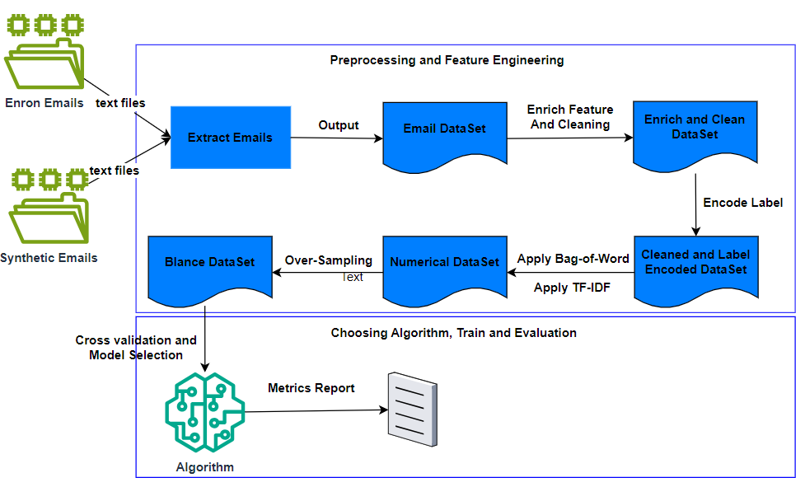
Creation Process

Slide 5
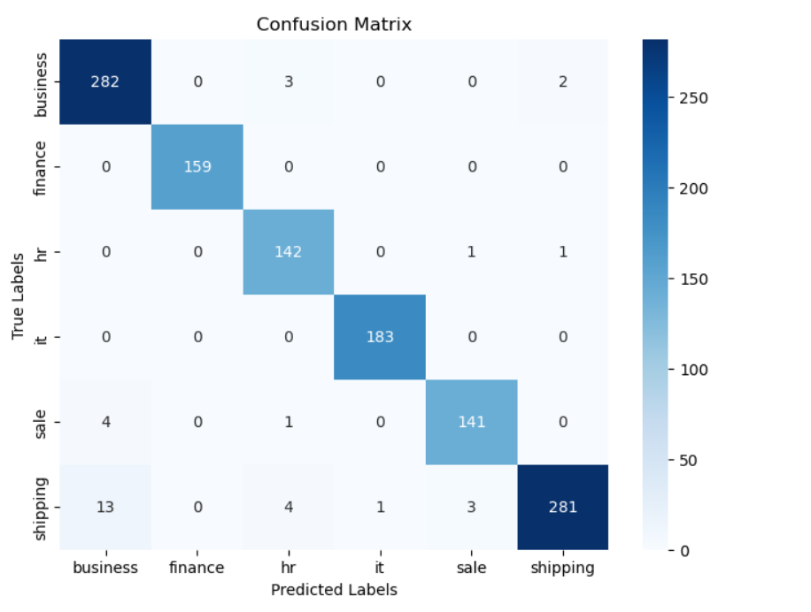
Confusion Matrix Report

Slide 6
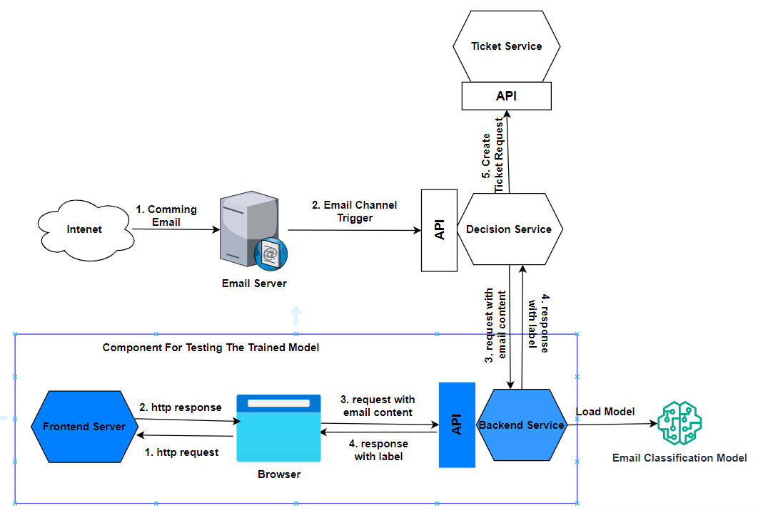
One Real Use Case

Slide 7
Thank you very much!

